Slide 1

Portfolio Milestone Project
Images are for illustrative purposes only.
Allison R. Hollingsworth Deming

Slide 2
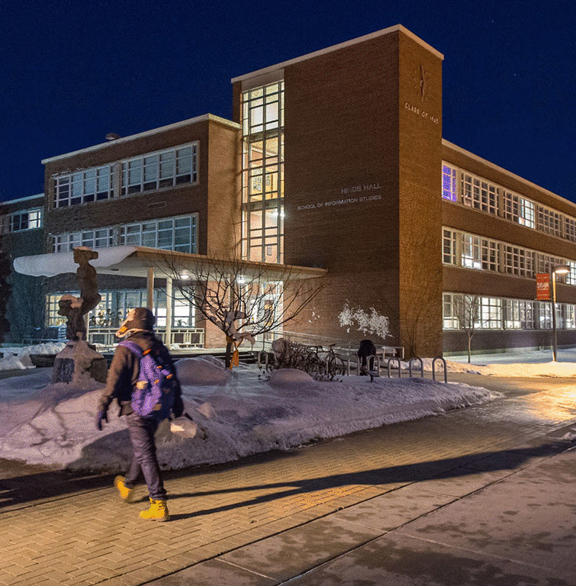
Introduction
iSchool

Slide 3
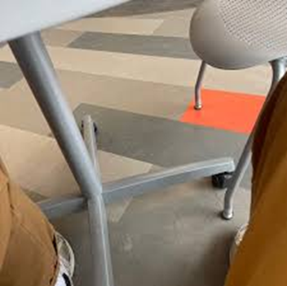
iSchool

Slide 4
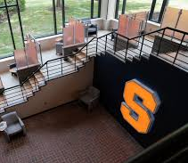
iSchool

Slide 5
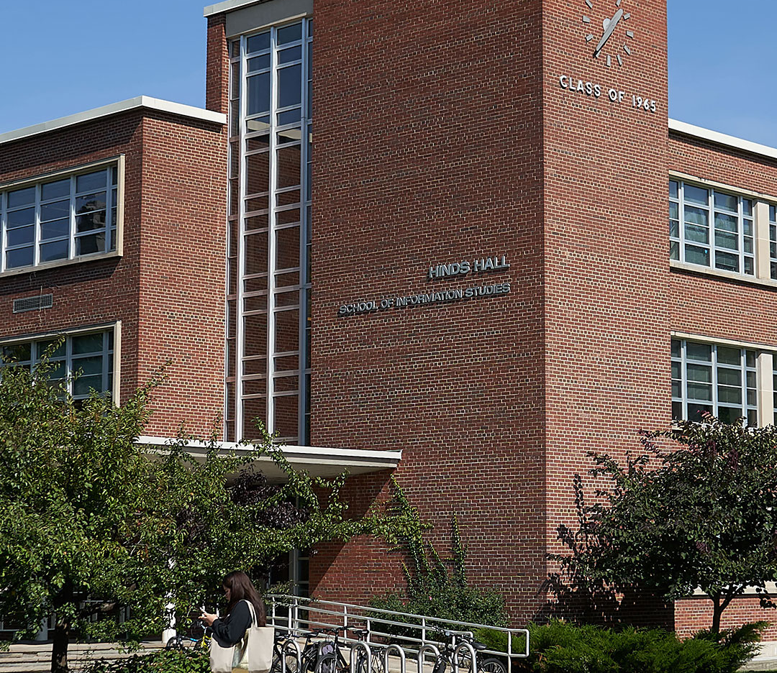
iSchool

Slide 6

iSchool

Slide 7
Introduction
iSchool

Slide 8
iSchool

Slide 9

iSchool

Slide 10
iSchool

Slide 11
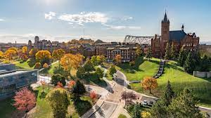
iSchool

Slide 12

iSchool

Slide 13
iSchool

Slide 14
iSchool

Slide 15
iSchool

Slide 16
iSchool
Notes:
Health
We are lucky here on campus to have many health care resources.
Local Emergency Rooms: or Urgent Cares:
Crouse Hospital or Crouse ExpressCare – ER copays
Five Star Urgent Care in Fayetteville – Lower copay
University Hospital or University Hospital-Community General Campus – ER copay
St. Joseph’s Hospital – ER copay
**This information can be found on the Barnes Center website
Before going to the emergency room, call the Barnes Center to discuss your options.

Slide 17
iSchool

Slide 18
iSchool

